Slide 1

File Downloader
Team members
Hazem Ahmed
Abdelrahman Mostafa
Abdelwahed Ragab
Fatma Hagag
Mohamed Nasser
Nourhan abdelmewally
Helwan University - Faculty of Computers & Artificial Intelligence –
Computer Science Department Module: CS471 Parallel processing and high-performance computing

Slide 2
OUTLINE
Project Abstraction
System Architecture
Web Client Versus HttpClient
Multi-threading
Multi-threading issues ( Deadlock )
Multi-threading vs Single Thread
Creativity & Innovation

Slide 3
Project Abstraction
File Downloader

Slide 4

Project Abstraction
The File Downloader application is designed to provide a seamless and efficient way to download multiple files concurrently. It leverages multithreading to handle multiple downloads in parallel
Our Project is modeled after

Slide 5



Project Abstraction
Technology Used
No Database Used
Since There is no important data for the user to save or to get

Slide 6
System Architecture
Service-Oriented Architecture
Services handle most of the logic and data operations.
Models are used to pass data between the GUI and services.

Slide 7
System Architecture

Slide 8
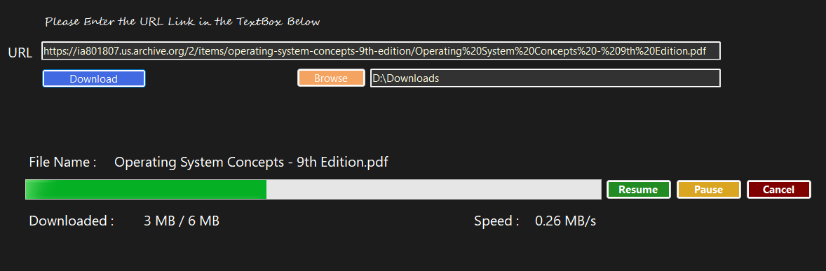
Project Main idea
The User sends to the a URL and it passes to the Service layer and then we use WebClient To download the File

Slide 9
Web-client versus http-client due parallelism
Web-client
HTTP-Client
Simple and straightforward for basic tasks.
Less efficient for large-scale operations.
Lacks robust support for cancellation tokens.
Slightly more complex but highly customizable.
Optimized for high-performance, scalable operations.
Fully supports cancellation tokens.

Slide 10
DUE TO CancellationToken
Web-client
HTTP-Client
WebClient doesn’t natively support cancellation tokens, Workarounds might involve forcibly aborting threads
Cancellation is handled gracefully using CancellationToken.
The application can cancel ongoing downloads instantly without resource leaks.

Slide 11
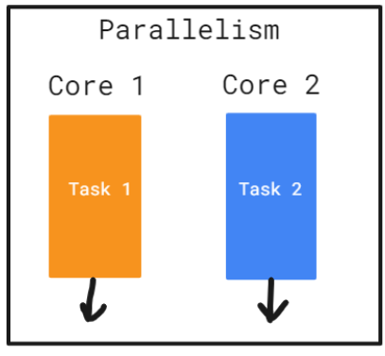
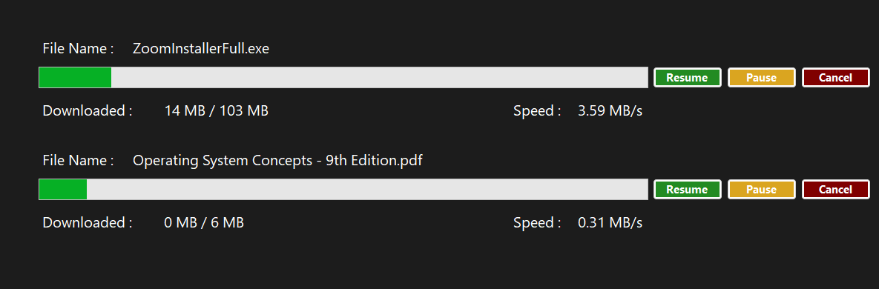
Multi-threading
Our application is able to download multiple files using Task

Slide 12


TASK VERSUS THREAD
TASK
THREAD
Higher-level abstraction built on top of threads
Fully integrates with async/await for seamless asynchronous programming.
Uses the ThreadPool, reducing overhead and improving scalability.
Low-level object representing
Does not directly support async/await.
Does not use thread pooling; each thread is independent.

Slide 13

Multi-threading
Using Semaphore
Concurrency Control: Limits how many threads can download files at the same time.
Resource Management: Ensures that only a set number of threads are active, preventing resource exhaustion

Slide 14
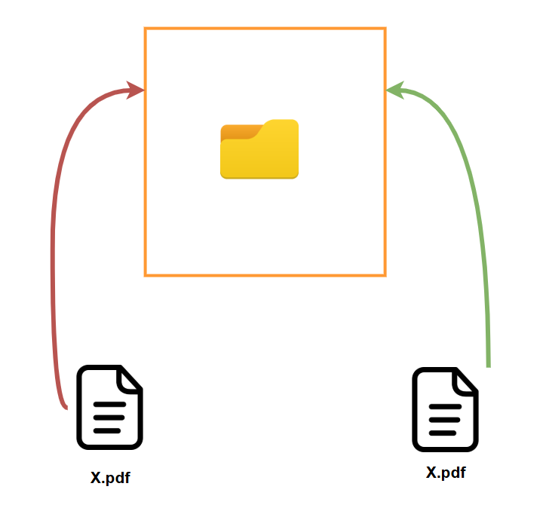

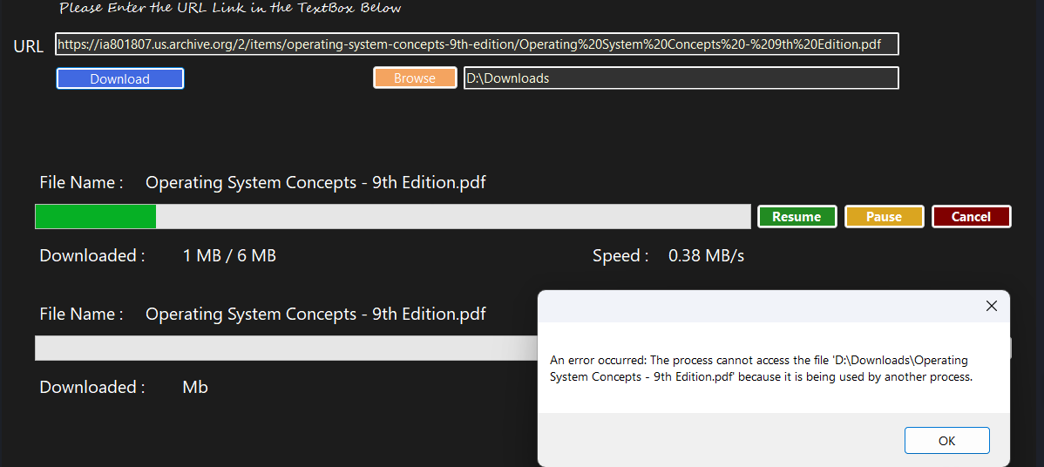
RACE-CONDITION
2 Files with the same name

Slide 15

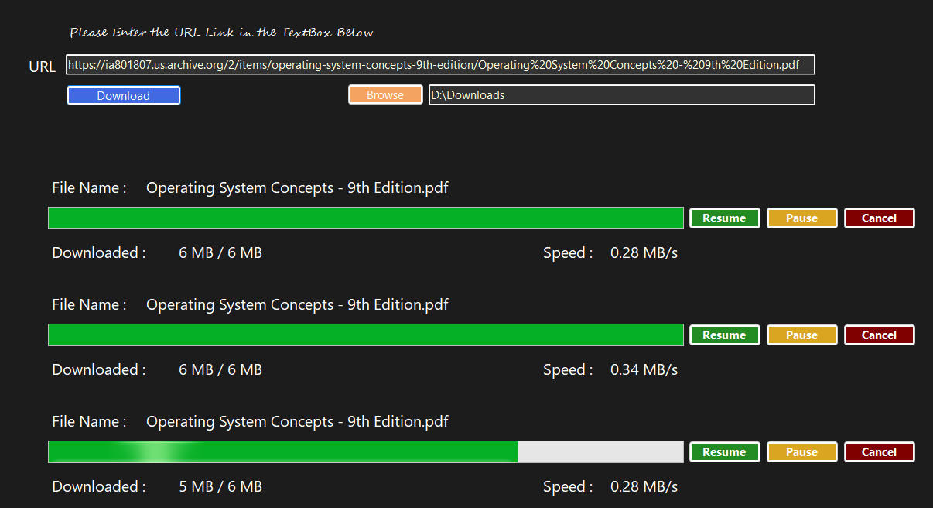
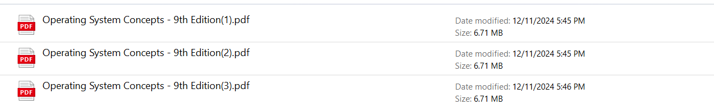
RACE-CONDITION
Solved With Unique Identifier for each file (sufix)

Slide 16
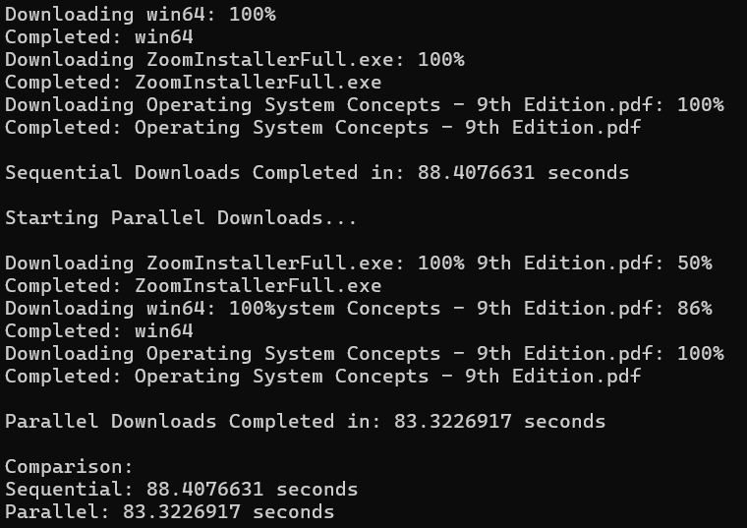
Multi-thread versus single-thread
Parallel downloads will likely be faster but may depend on factors like network bandwidth and server limitations.
Parallel downloads might use more CPU resources due to multiple simultaneous tasks.
Parallel downloads might consume more memory due to maintaining multiple threads or tasks concurrently.

Slide 17
Creativity & Inovation
File Downloader

Slide 18

FEATURE
project reflect a realistic and challenging problem?
Since ther is no Built-in Downloader to your own device on youtube Client we decided to add a new sERVICE

Slide 19
FEATURE
now our program supports downloading youtube videos also

Slide 20
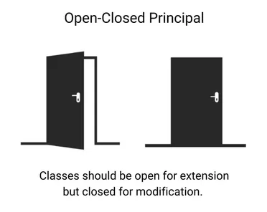
Solid principles
open closed principle
In this way we have applied the open-closed principal and we can add more services in the future

Slide 21
Thanks

